Slide 1
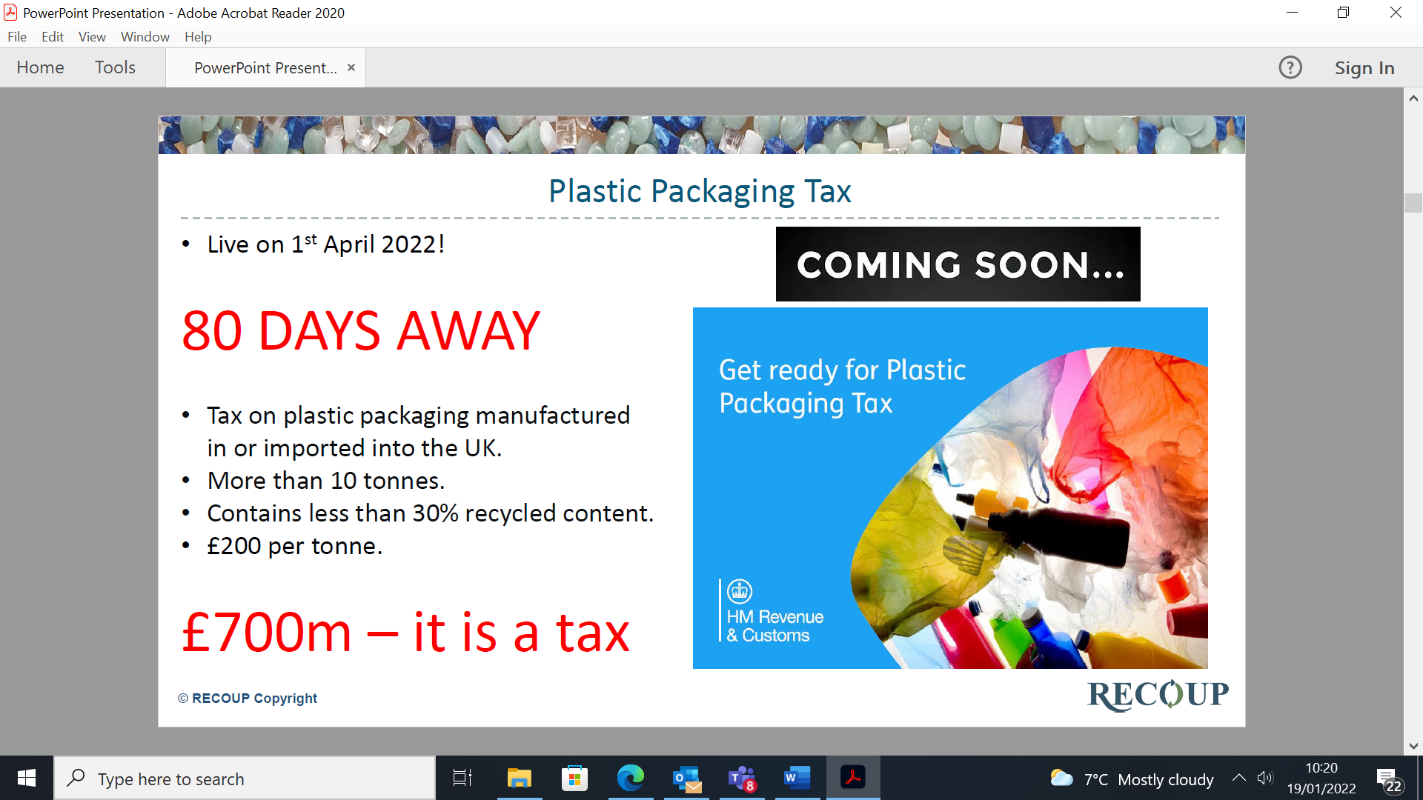
UK Plastic Packaging Tax – what is it ?
Cellulose based polymers are NOT in scope of the Plastic Packaging Tax.(PPT)
Biodegradable and bio based and compostable packaging ARE included in the scope of the PPT.
Primary function packaging e.g. lunch boxes are NOT in scope of the PPT.

Slide 2
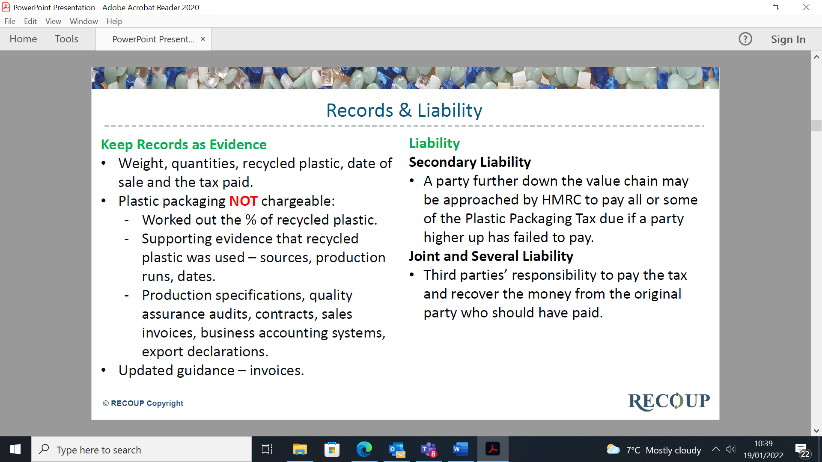
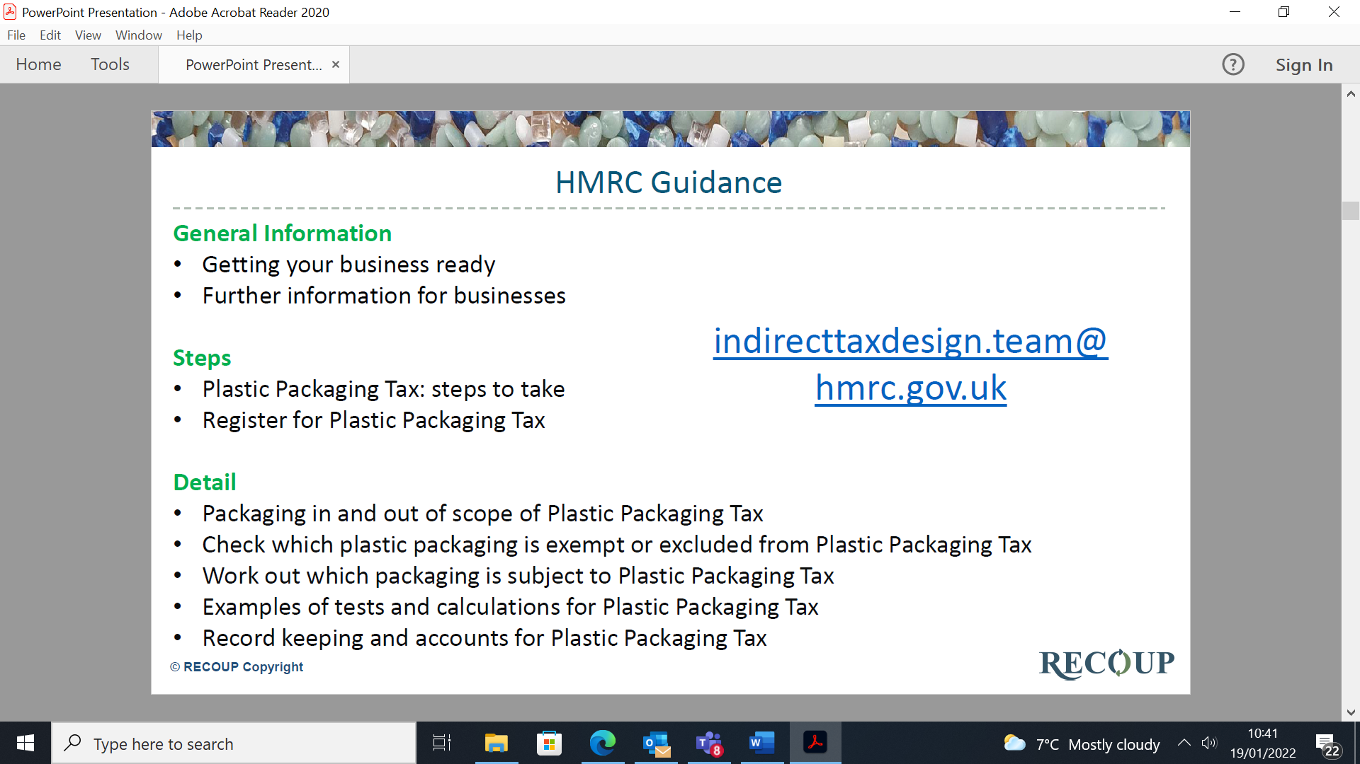
Plastic Packaging Tax: the details

Slide 3
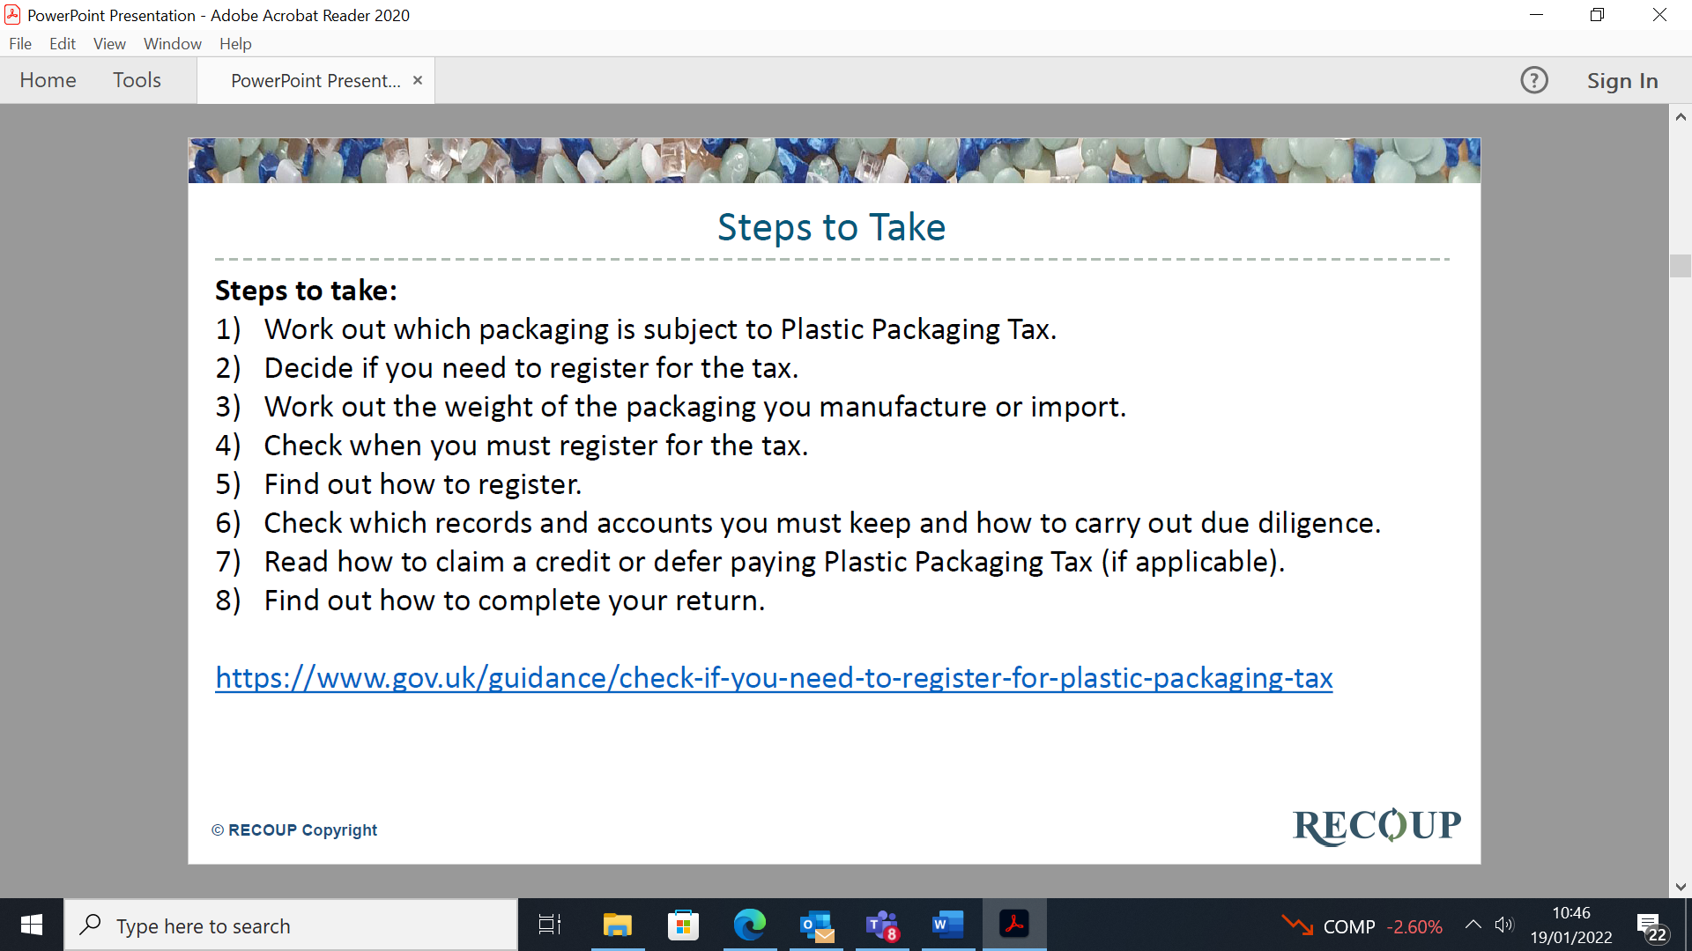
HMRC

