Slide 1
Take Action Today Put Them Away
A campaign to reduce household poisoning among children under five
Sheila Merrill
Public Health Adviser
Errol Taylor
Chief Executive

Slide 2
The Problem
Most accidental poisoning happens to children younger than five years old.
In the UK there are over 16,000 hospital overnight admissions every year
Most involved medicines(70%) cleaning products (20%)
children aged one to three years most at risk
Children from the poorest families are three times more likely to be admitted to hospital due to an accident, including accidental poisoning

Slide 3
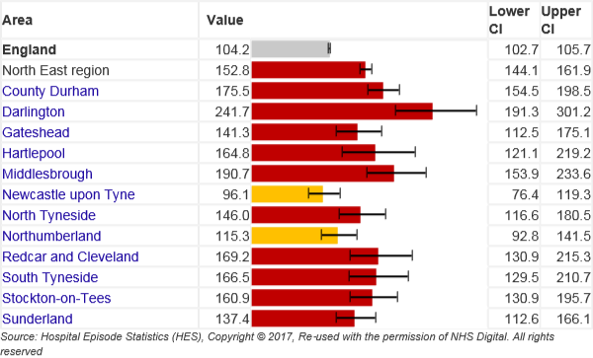
Selection of target areas
Emergency hospital admissions due to poisoning from medicines (aged 0-4 years)2011/12 - 15/16 Rate - per 100,000

Slide 4
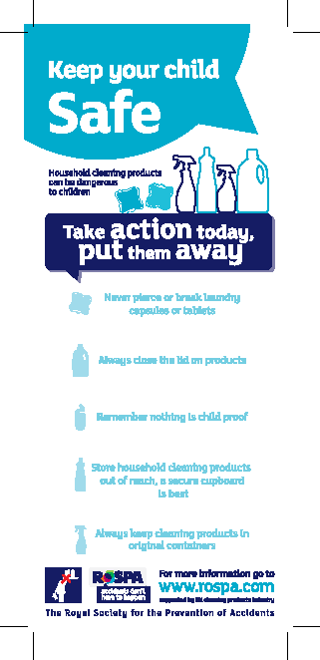
The Programme
Take Action Today, Keep Them Away is an industry supported campaign funded by the UKCPI under the Product Stewardship Programme for Liquid Laundry Detergent Capsules
Raising awareness of the potential for accidents and how to prevent them
Developing safer products on the market
Now in its fifth year

Slide 5
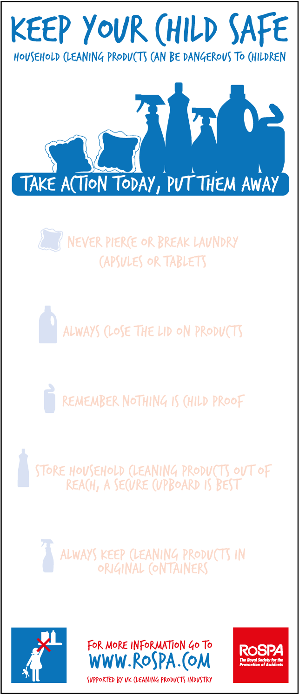
The Tools
Briefing pack
The magnetic pads – visual reminder for the home
Checklists for use with and by parents
Factsheets
Feedback forms
All of theses can be downloaded from:
https://www.rospa.com/home-safety/advice/child-safety/household-cleaning-products/

Slide 6
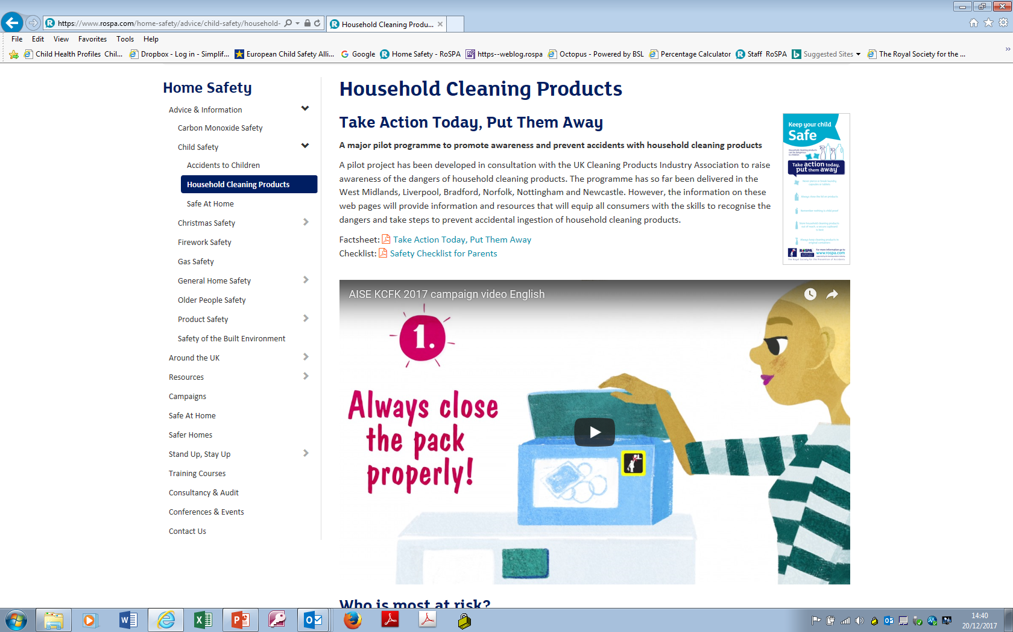
The Website
Videos
Case studies
PDFs of all resources
Evaluation reports

Slide 7
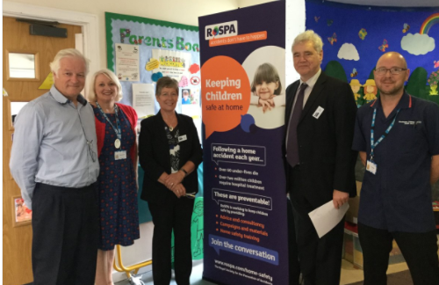
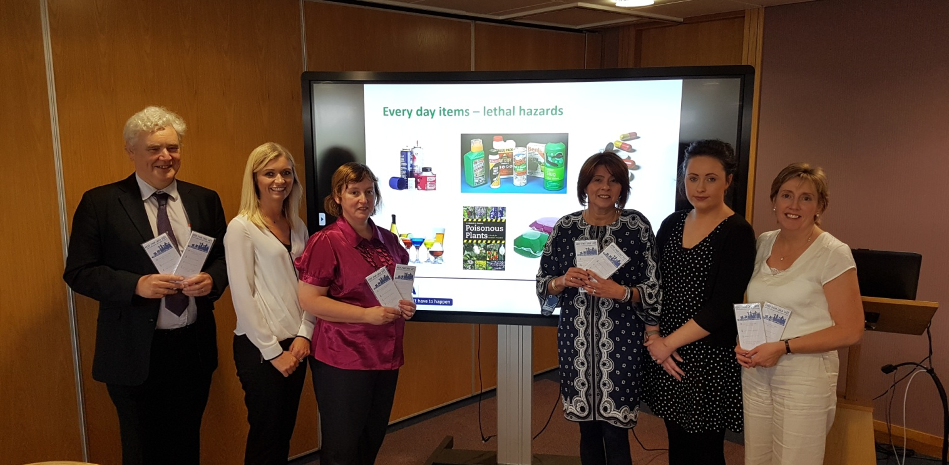
So far...
Launched in twelve regions
140 local partners have delivered the programme.
Social media regularly reached up to 26,000 people.
At least 400,000 families responsible for young children will have received advice and resources
over 4 million people reached through National television, radio and newspapers

Slide 8
So far...
Birmingham
Liverpool
Norfolk
Bradford
Nottingham
Newcastle
Hampshire
Northern Ireland
Lincolnshire
Stockton-on-Tees
Chester and Cheshire West
East Ayrshire

Slide 9
11,000 of the magnetic notepads. To date 9,500 distributed via
  Health visiting teams
  10x Belfast Sure Starts
  Family Nurse Partnership
  Local primary schools
  Home Start
  Belfast Health and Social Care Trust – Health Improvement Team
  Family Support Hubs
  Volunteer Now
  Home safety check scheme in Belfast (approx. 1,450 home visits per year) as well as health fairs.
  300 during events as part of RoSPA Family Safety week.
Example: Belfast
feedback has been positive and Sure Starts have requested more…

Slide 10
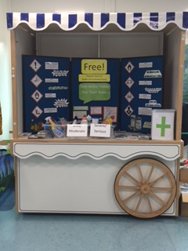
Example: Stockton-on-Tees
Incorporated into monthly Home Safety Sessions for parents/carers from our 4 family hubs within Stockton.
Events in public libraries, family hubs, community venues, healthy start clinics, shopping centres and local hospital (North Tees).
All health visiting/school nurse teams (over 50 professionals) are using the notepad out whilst engaging with families.
Free child safety information leaflets (including poisoning) and free packs of drawer/cupboard catches along with the free magnetic notepad.

Slide 11
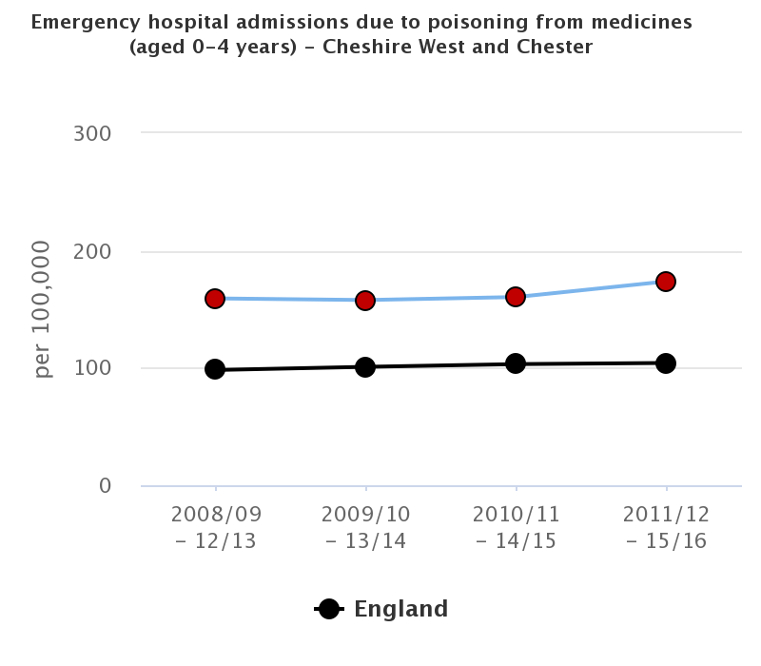
Cheshire West and Chester
Launched 7 June 2018
led by children’s centre staff from Cheshire and Wirral Partnership NHS Foundation Trust (CWP).
Cheshire West and Chester Council (CWaC),
Countess of Chester Hospital NHS Foundation Trust (CoCH) a
West Cheshire and Vale Royal (CCGs).
Family Intervention Workers,
Social Workers
Leighton Hospital and GP surgeries
Results for Cheshire, Northern Ireland
And Stockton to be followed up in 2019

Slide 12
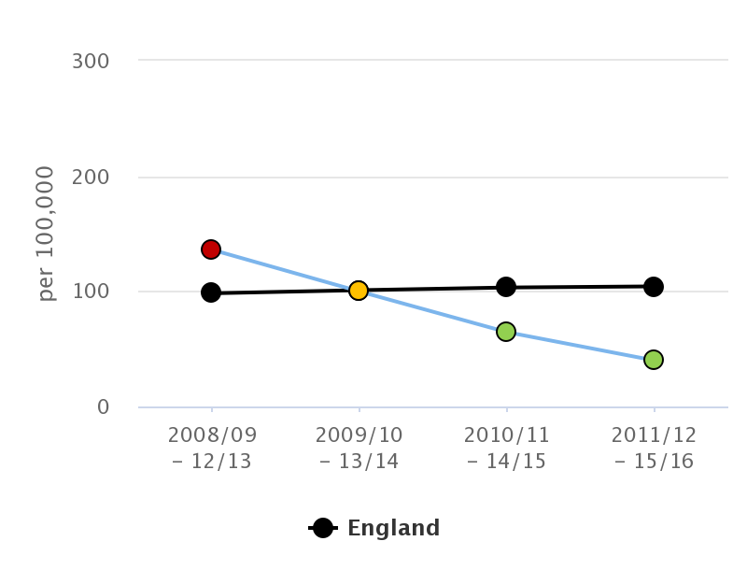
Does it make a difference?
Emergency admissions from poisonings: Liverpool:

Slide 13
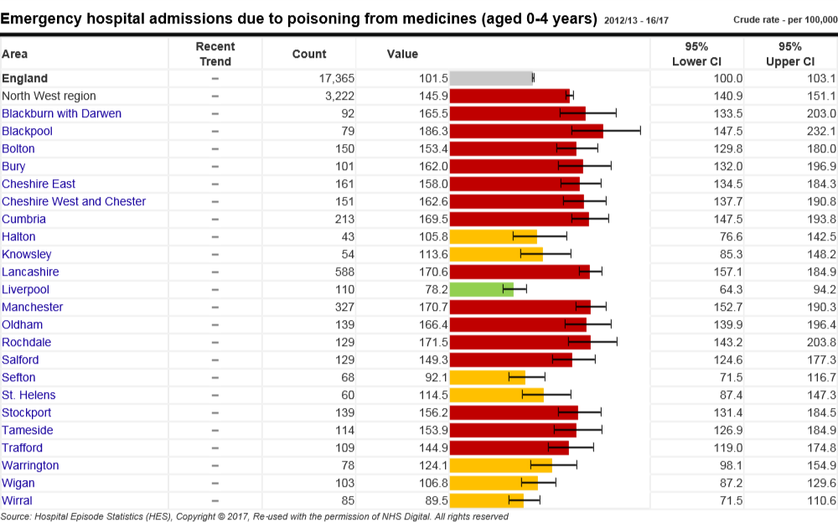
Does it make a difference?
Emergency admissions from poisonings: Liverpool:

Slide 14
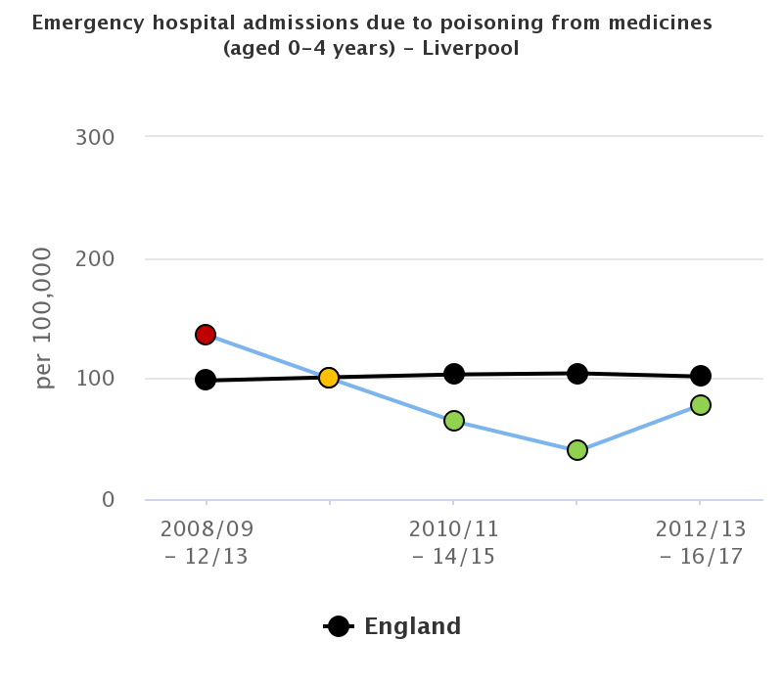
Importance of keeping up momentum
Emergency admissions from poisonings: Liverpool: Increasing

Slide 15
Does it make a difference?

Slide 16
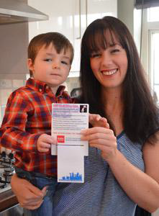
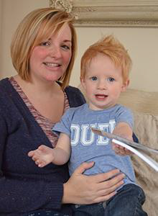
Real life....
"I left a liquid laundry capsule in the washing machine drum, ready for the next wash, and Zachary picked it up and squeezed it in both of his eyes. I've never heard him scream like it and I hope I never will again.“ Gemma, Birmingham
"It only took the briefest of moments for Hayden to get into the kitchen cupboard and go straight for a liquid laundry capsule. I'd just had a new kitchen fitted and hadn’t got round to putting locks or safety catches on the cupboards...one of the scariest experiences of my life and since that day, all the household cleaning products are high up and out of reach.” Roxanne, Cradley Heath

Slide 17
What parents say...
“Never thought about it until now”
“Makes you think”
“Great. Keep it up. Awareness is what we need”
“Will tell my mum and dad too”
“Consider giving homes of grandparents this information”
“Scary to think how many drink them
“My child thinks the capsules are like a candy crush game”
“Will stick to my fridge to remind me, thanks”
“Been to hospital already, so locked away now”

Slide 18
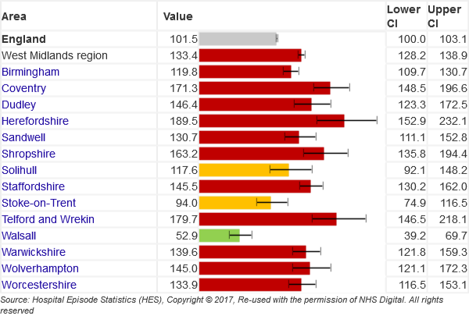
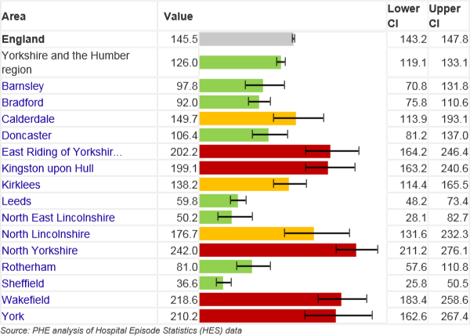
The Programme – what next
Launch in various locations in Warwickshire (Leamington, Rugby, Nuneaton) December 2018
Kingston upon Hull February 2019
Other areas of West Midlands (including Coventry, Solihull Birmingham) 2019

Slide 19


Thank you!
www.rospa.com
smerrill@rospa.com

